Slide 1
Netflix Eureka

Slide 2
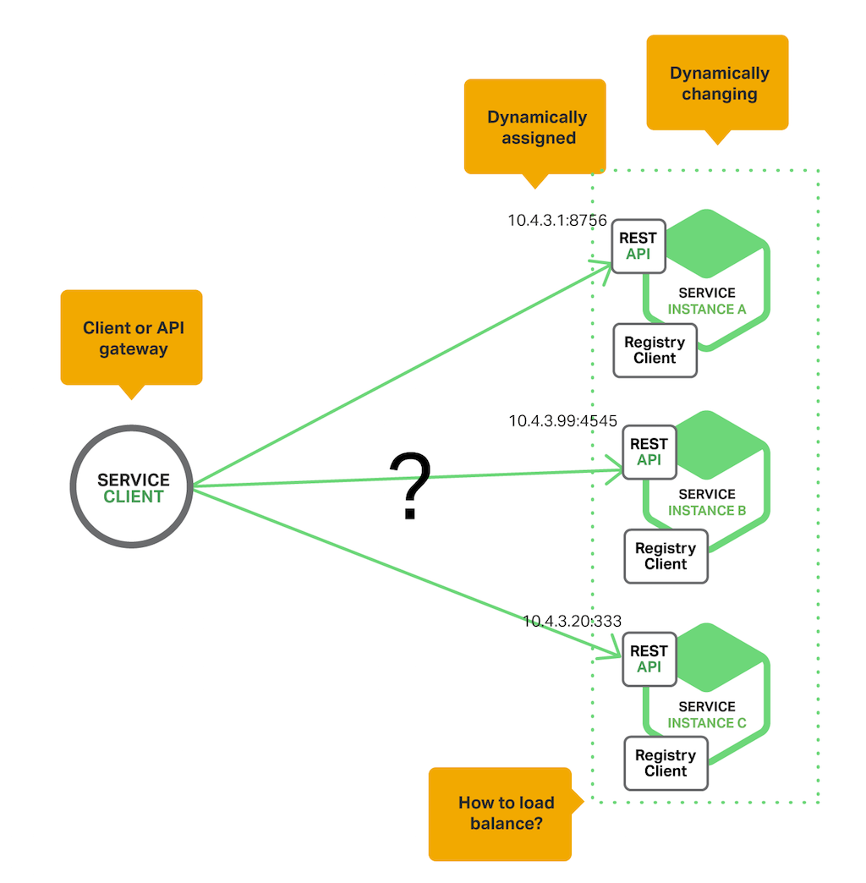
Why do we need it?

Slide 3
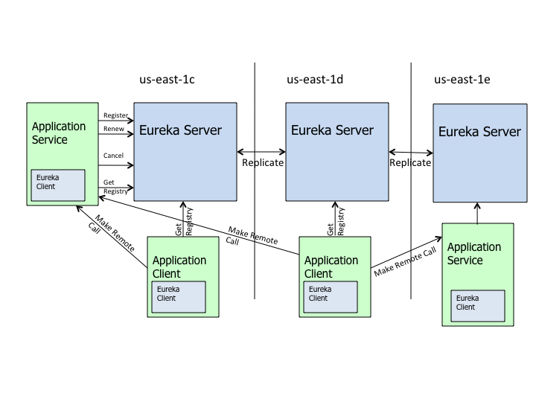
What’s changing?

Slide 4
Hystrix

Slide 5
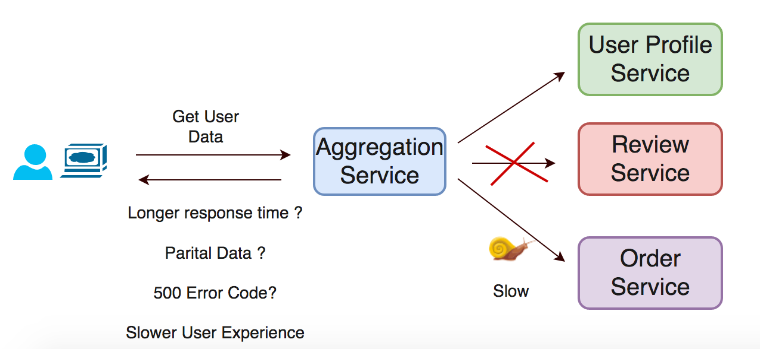

Slide 6
